Slide 1
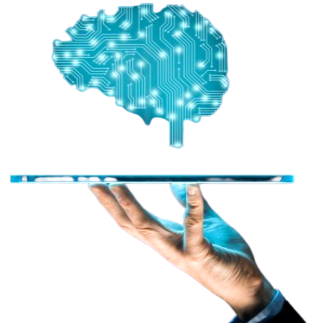
Transfer Learning
By: Biswajit Panda
Regd. no.: 1701329041
Branch: Computer Science & Engineering

Slide 2

What will we learn in this presentation?
Definition of TL
What is Machine Learning?
Artificial Neural Network
How TL Works?
Some Examples of TL
More Intuition of TL
Pros and Cons of TL
Some Pretrained Models
Tools
Latest Discoveries
References

Slide 3
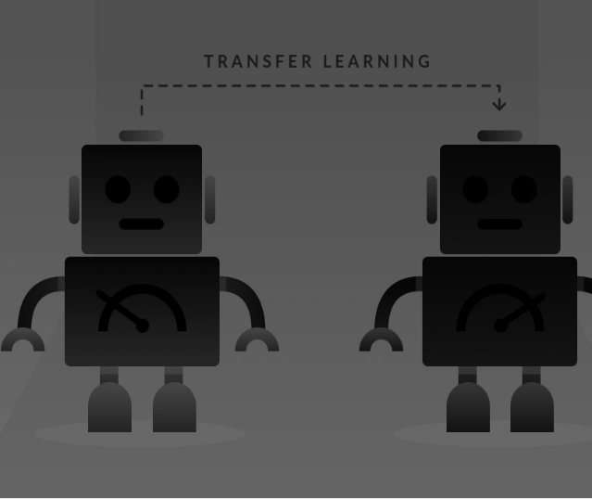
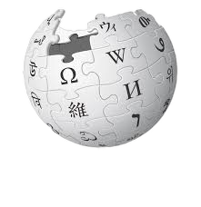

Definition :
Transfer Learning is a research problem in Machine Learning that focuses on storing knowledge gained while solving one problem and applying it to a different but related problem. For example, knowledge gained while learning to recognize cars could apply when trying to recognize trucks. Wikipedia
Transfer of learning(a psychological point of view): The study of dependency of human conduct, learning or performance on prior experience.
[Throndike and Woodworth, 1901] explored how individuals would transfer in one context to another context that share similar characteristics.

Slide 4

Applications
Text Classification
Object Recognition
Spam Filtering
Cancer Subtype Discovery
Medical Research
General Game playing
Building Utilization

Slide 5
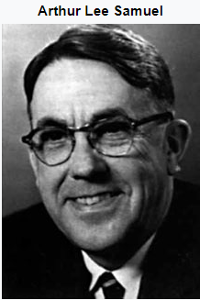
Machine Learning
In 1959, Arthur Samuel defined Machine Learning as a “Field of study that gives computers the ability to learn without being explicitly programmed”.
(1901-90)

Slide 6
Machine Learning
Supervised Learning

Slide 7
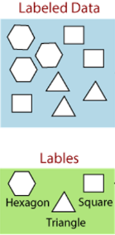
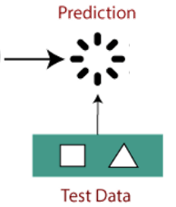
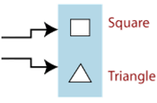
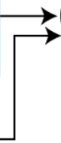


Supervised Learning

Slide 8
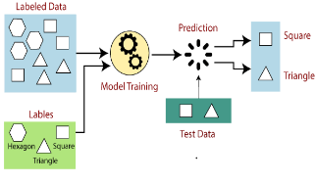
Machine Learning
Supervised Learning
Unupervised Learning

Slide 9
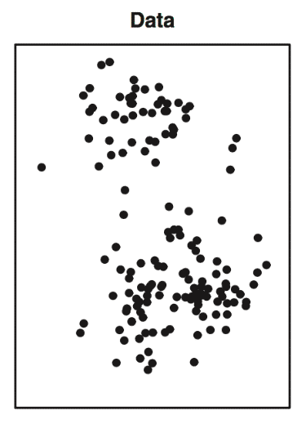
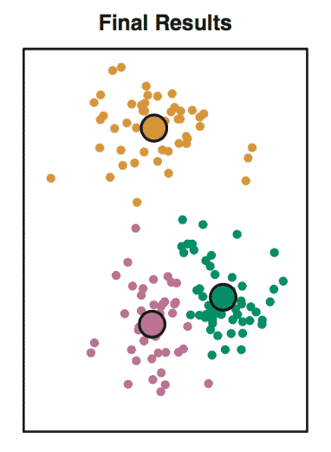
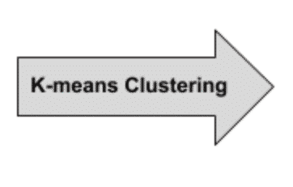
Unsupervised Learning

Slide 10
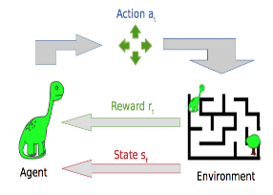
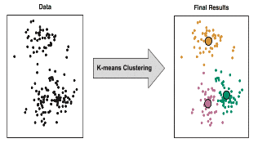
Machine Learning
Supervised Learning
Reinforcement Learning
Unupervised Learning

Slide 11
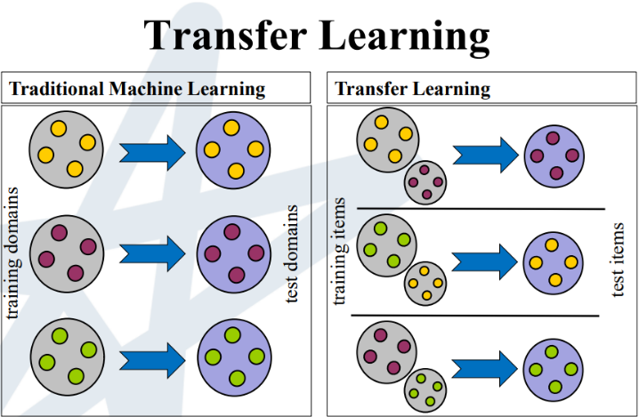
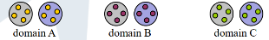

Slide 12

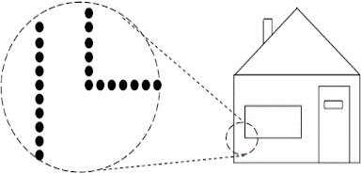
Features:
Base Area
No of Rooms
Image Data
Location
X1
Parking lot
X2
facilities
X3
X4

Slide 13
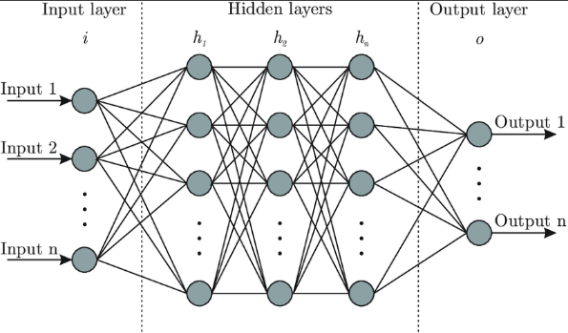
Artificial Neural Networks
Features
ŷ
y_{actual}
Error
Feed-Forward
Back-Propagation

Slide 14
How Transfer Learning works?

Slide 15
MODEL
Last remaining layer
Output
Predictions in 1000 categories
Input
ŷ
Simple Shapes
Prediction
Layer
Complex visual patterns

Slide 16
Last remaining layer
New prediction layer
y1
y2

Slide 17

Some Examples of TL

Slide 18
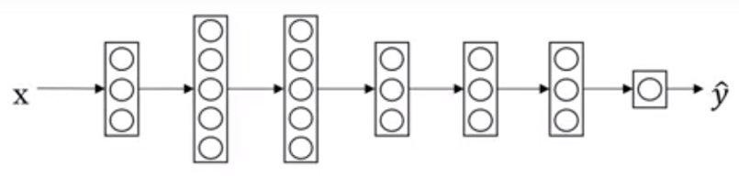
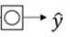
Example 1:
Image Recognition
Image
Image recognition
Radiology diagnosis
Some features:
-> edges
-> curves
-> objects
weights and bias

Slide 19
Example 2:
Text Recognition
Image
Text Recognition
Recognising other Languages
Some features:
-> text detection
-> separation of letters
-> letter recognition
-> word formation
weights and bias

Slide 20


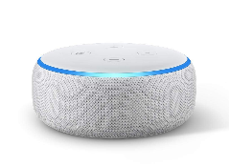
Example 3:
Speech Recognition
Audio
Speech Recognition
Some features:
-> signal processing
-> noise isolation
-> power, pitch
-> vocal tract configuration
Wake word/ Triggered word detection
weights and bias

Slide 21

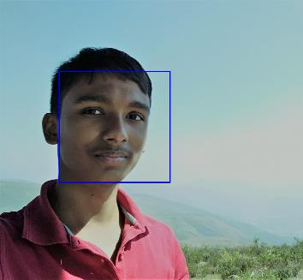

Face Recognition

Slide 22










KNOWN_FACES
PRANOY
UDIT
SURYA
RAJ
BISWAJIT

Slide 23
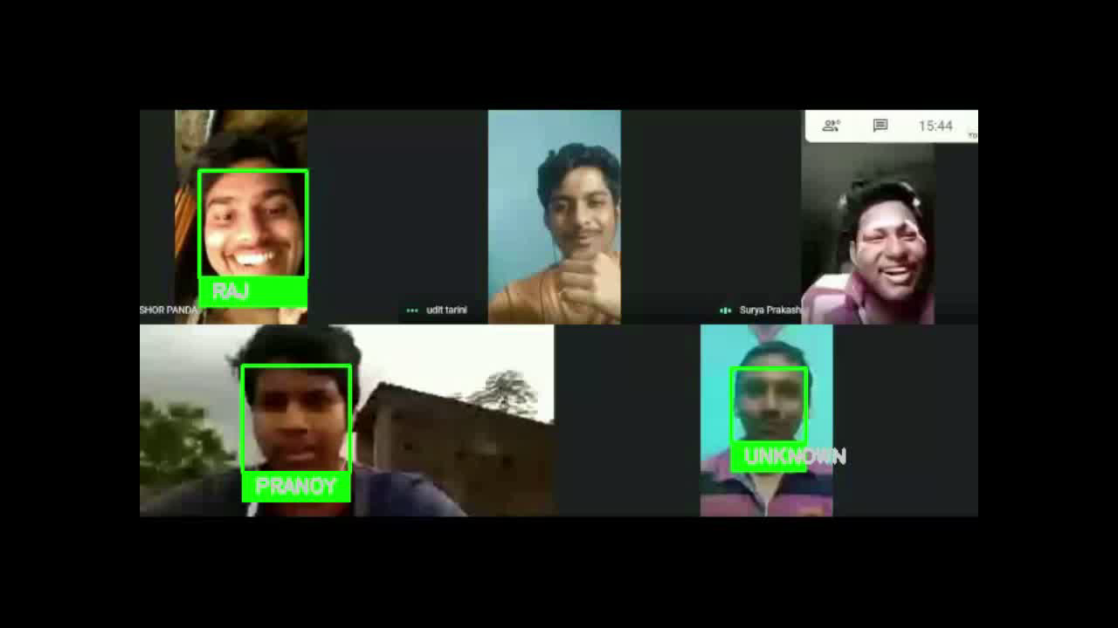

Slide 24
When does Transfer Learning Make sense?

Slide 25

Image recognition
Radiology diagnosis
A
B
More Data
Less Data

Slide 26
Radiology diagnosis
Image recognition
B
A
More Data
Less Data

Slide 27
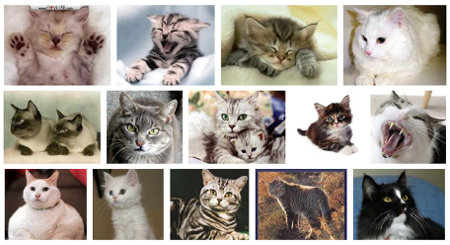
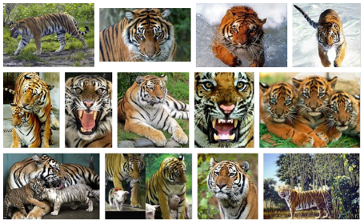
Examples:

Slide 28
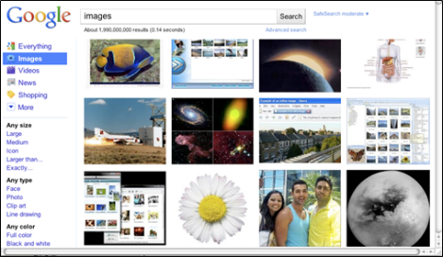
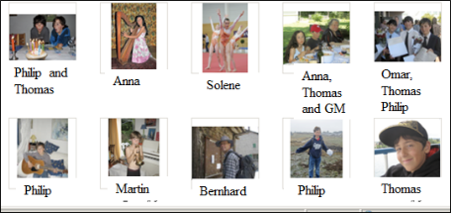
Examples:
Help us learn about Personal data
Publicly available data

Slide 29
Pros and Cons of TL:
Pros:
Easy to make model
Cost efficient
Less training time
More efficient (Training similar model)
Require less memory space
Cons:
Not applicable for all training sets
Less efficient than the models which are build from scratch

Slide 30

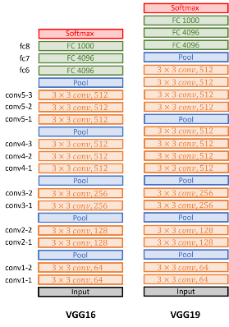
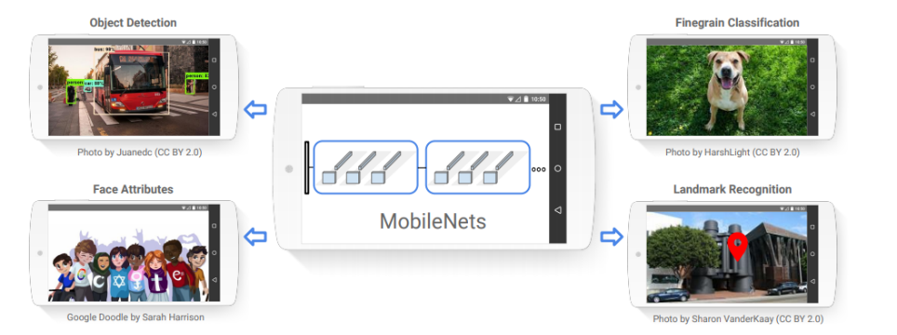
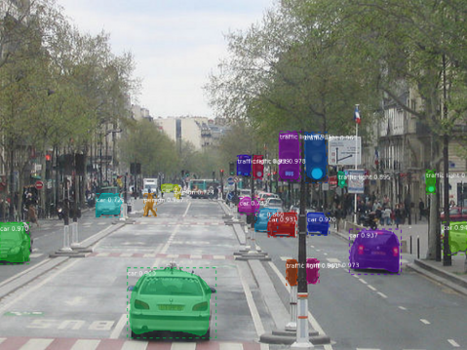
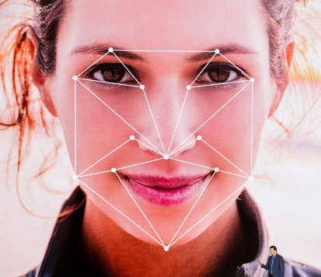
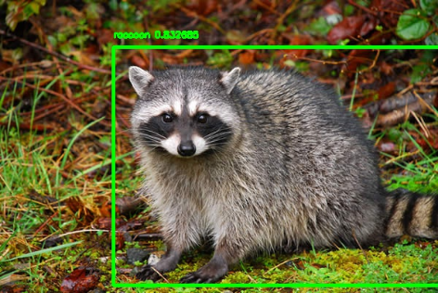
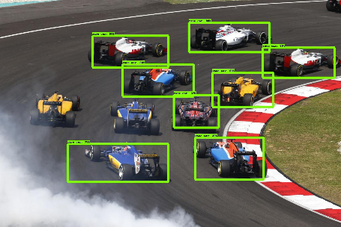
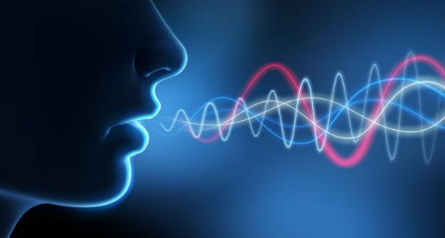
Some Examples of Pretrained Models:
Object Detection
Mask R-CNN
YOLOv2
MobileNet
Car Classification(VGG16, VGG19)
Face Recognition
VGG-Face Model
Multi-Purpose NLP Models
ULFMiT
Transformer
Google’s BERT

Slide 31




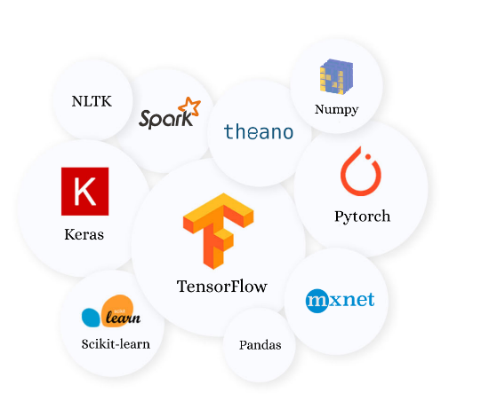

Tools

Slide 32
Latest Discoveries
In 2020 it was discovered that, due to their similar physical natures, transfer learning is possible between Electromyographic (EMG) signals from the muscles when classifying the behaviours of Electroencephalographic (EEG) brainwaves from the gesture recognition domain to the mental state recognition domain. It was also noted that this relationship worked vice-versa, showing that EEG can likewise be used to classify EMG in addition^{[22]}. The experiments noted that the accuracy of neural networks and convolutional neural networks were improved through transfer learning both at the first epoch (prior to any learning, ie. compared to standard random weight distribution) and at the asymptote (the end of the learning process). That is, algorithms are improved by exposure to another domain.

Slide 33
References:
Google
Wikipedia (en.wikipedia.org/wiki/Transfer_learning)
YouTube (Deeplearning.ai) By Andrew Ng
Kaggle (www.kaggle.com)
www.analyticsvidhya.com
www.pythonprogramming.net
Google Colab

Slide 34
Thank You

